Slide 1

SHEIN E-commerce Platform Database
Team 3
Zhiqing Wang, Wenwei Li,
Chengran He, Jiayue Han, Xinan Wang

Slide 2


Content
Introduction
Entity Relationship Diagram (ERD) Design
Database Implementation
Data Definition Language (DDL)
Computed Column (Age and Order Amount)
Table-level Constraint Check Function (Return Request and Unique Name)
Encrypted Colmn (Customer Password)
View to connect PowerBI
PowerBI Visualization
Notes:
This is team 3, presenting our ecommerce platform database. Our presentation consists of four parts. In part 1 we would briefly introduce our project, in part 2 we would go over the entity relationship diagram we design. Part 3 is about database implementation. We would cover data definition language, computed column, table level constraint, encrypted column, and view to connect power bi. Part 4 is the visualization of our data.

Slide 3


1. Introduction
Why Shein?
Overtook Amazon to become the most downloaded App in the U.S. last year.
Largest fast fashion retailer (surpassing its rivals like H&M and Zara).
Notes:
The reason we chose to design a ecommerce platform database to assemble the fast fashion company shein is that Shein is a fast fashion company from China that just overtook Amazon to became the most downloaded shopping App in the U.S. last year. It also became the largest fast fashion retailer in the US last year, surpassing its rivals like H&M, Zara, and Forever 21. Therefore we would like to look into the business model of Shein and gain some insights about what makes Shein successful.

Slide 4
1. Introduction—business rules
Each customer has a unique profile.
Customer can add products to shopping cart
Each customer can create a wish list.
Each order has an associated shipping info, payment info and return info.
A constraint that ensure each customer's name is unique.
A constraint that reject return if the return request was made over 30 days ago.
Notes:
The reason we chose to design a ecommerce platform database to assemble the fast fashion company shein is that Shein is a company from China that just overtook Amazon to became the most downloaded shopping App in the U.S. last year. It also became the largest fast fashion retailer in the US last year, surpassing its rivals like H&M, Zara, and Forever 21. Therefore we would like to look into the business model of Shein and gain some insights about what makes Shein successful.

Slide 5
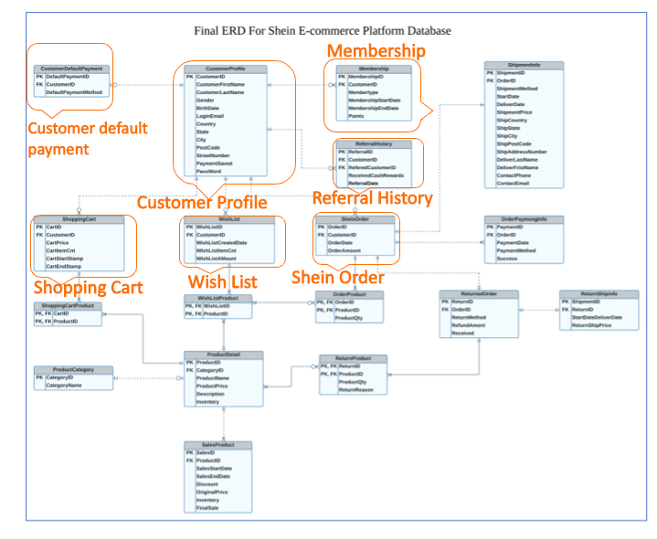
2. ERD
First group: Customer related information

Slide 6
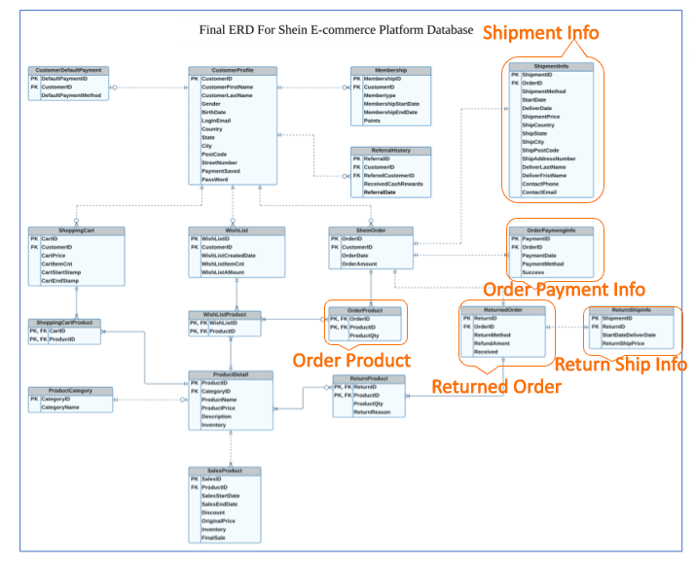
2. ERD (continue)
Second group: order related information

Slide 7
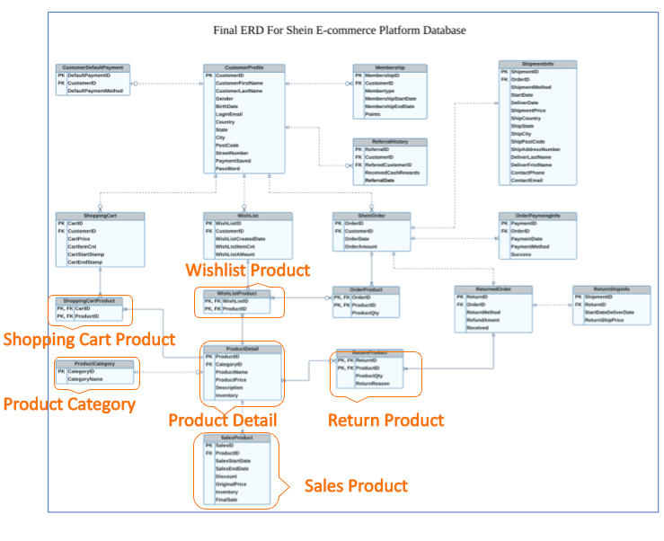
2. ERD (continue)
Third group: Products related information

Slide 8
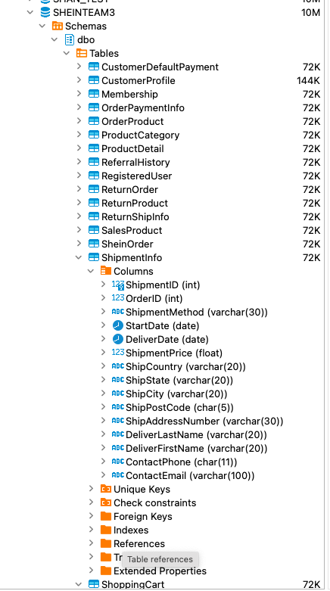
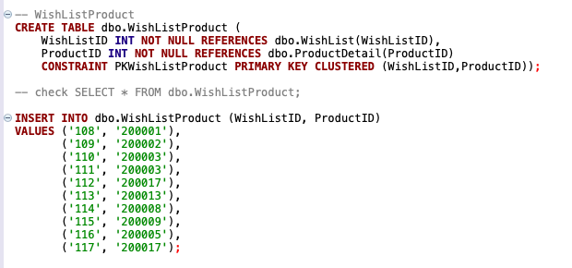
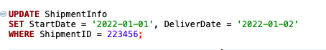
3.1 Database Definition Language (DDL)
Create table by defining key, data type, reference, and clustered Constraints
Insert values to table following the orders of CustomerProfile, ProductDetail, and SheinOrder, then other related entities based on the business rules and final ERD
Updated values to ensure the correctness of the table-level constraint check function and the visualization

Slide 9
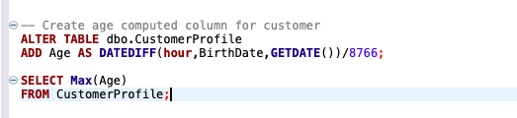
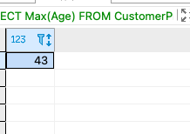
3.2 Computed column
Compute Age from BirthDate in CustomerProfile

Slide 10
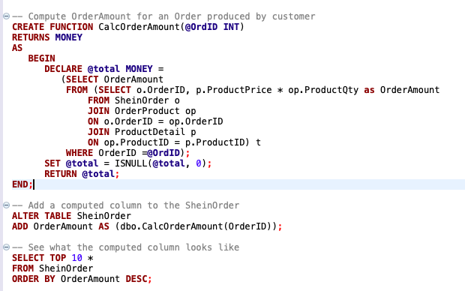
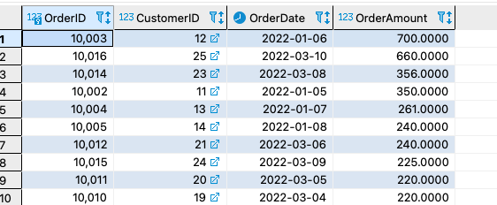
3.2 Computed column
Compute OrderAmount from SheinOrder, ProductDetail, and OrderProduct

Slide 11
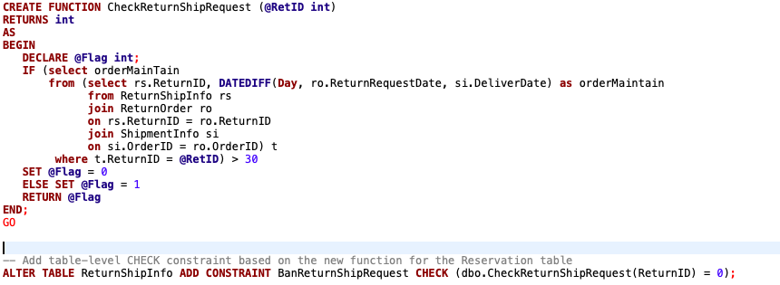
3.3 Table level constraints, check order request
Create table-level check function that a return shipment can't be issued if a return request date is larger than 30 day from the order deliver day

Slide 12
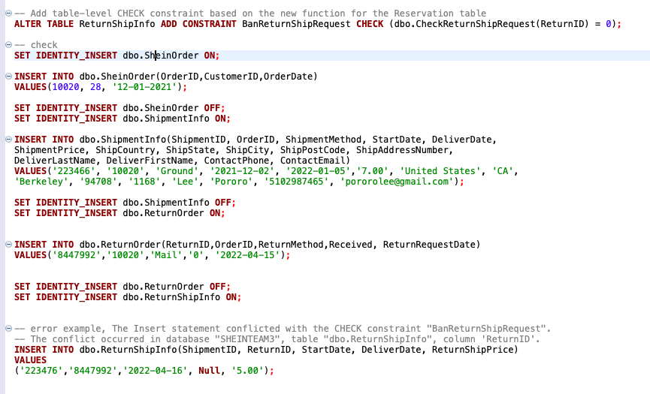
3.3 Table level constraints, check order request
Insert a return request value not within 30 days since the deliver date
Error example, The Insert statement conflicted with the CHECK constraint "BanReturnShipRequest". The conflict occurred in database "SHEINTEAM3", table "dbo.ReturnShipInfo", column 'ReturnID'.

Slide 13
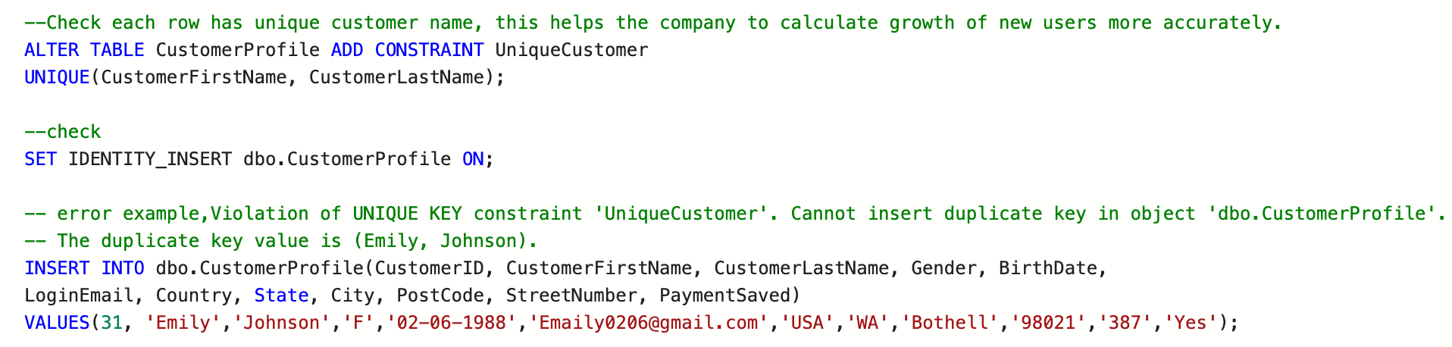
3.3 Table level constraints, unique customer
Check that each customer name entered in unique;
This helps the company gain insights about real customer growth.
Error example: Violation of UNIQUE KEY constraint 'UniqueCustomer'. Cannot insert duplicate key in object 'dbo.CustomerProfile'. The duplicate key value is (Emily, Johnson).

Slide 14
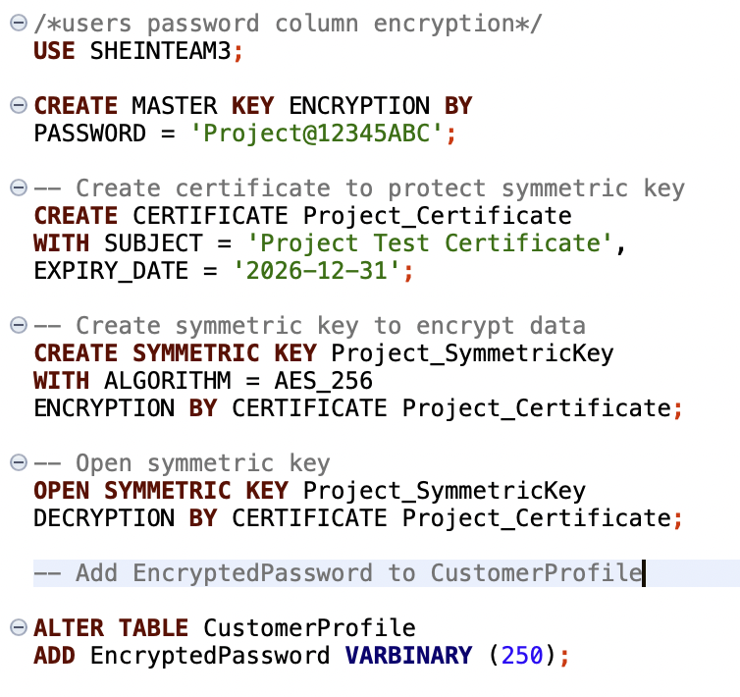
3.4 Encrypted column
Use Encrypted Password to Customer Password

Slide 15
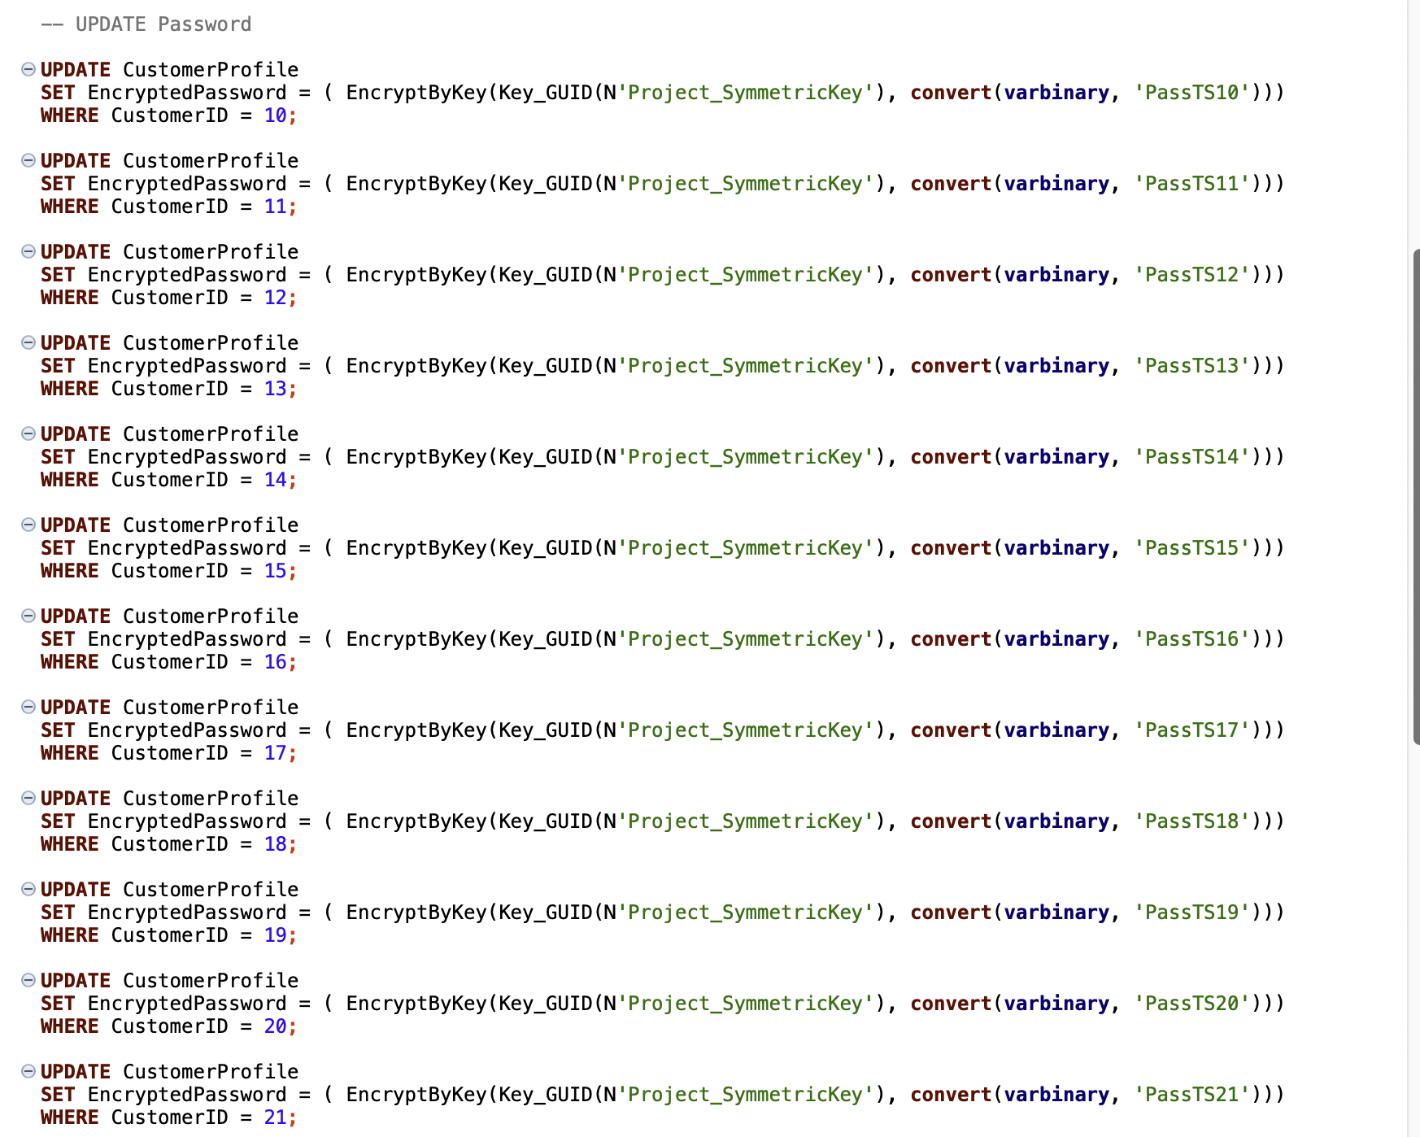
Update Password
Default password

Slide 16
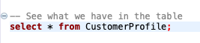
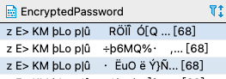
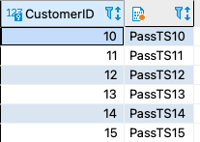
Encrypted and Decrypt Password

Slide 17
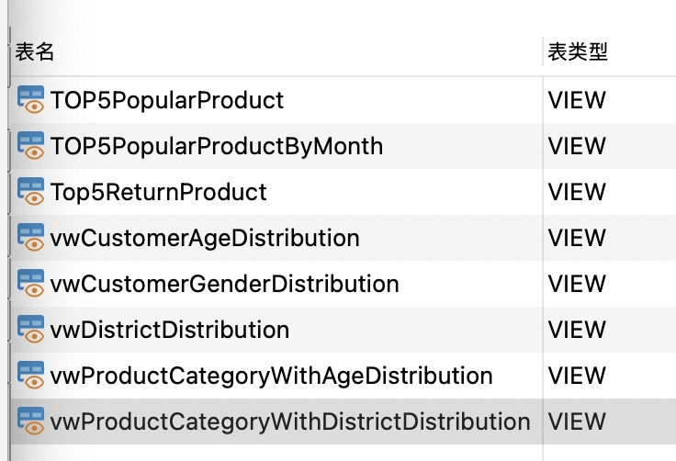
3.5 Views to connect PowerBI
We set up 8 view topics in total and wrote 8 queries for each of them. The upper right corner is the topics we choose, and the lower right corner is the example we wrote based on these topics. Then we import these views tables to Power BI.

Slide 18
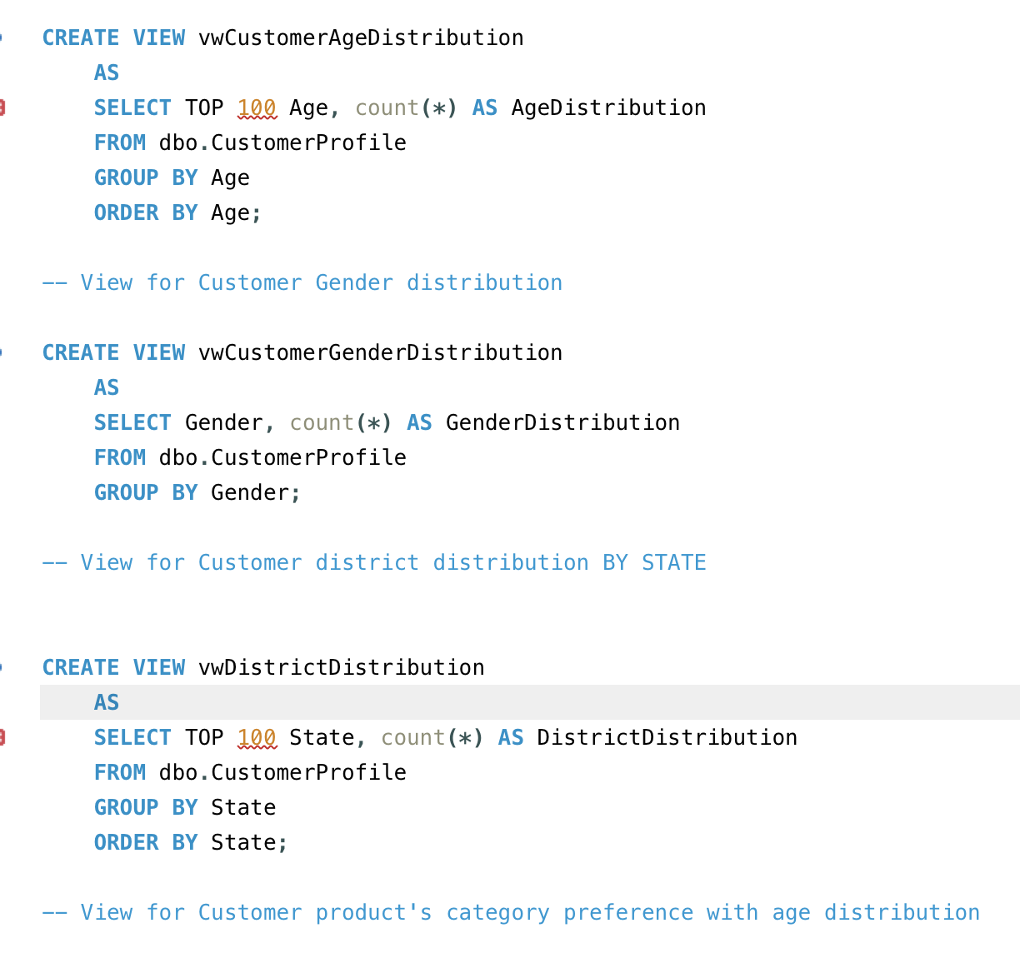
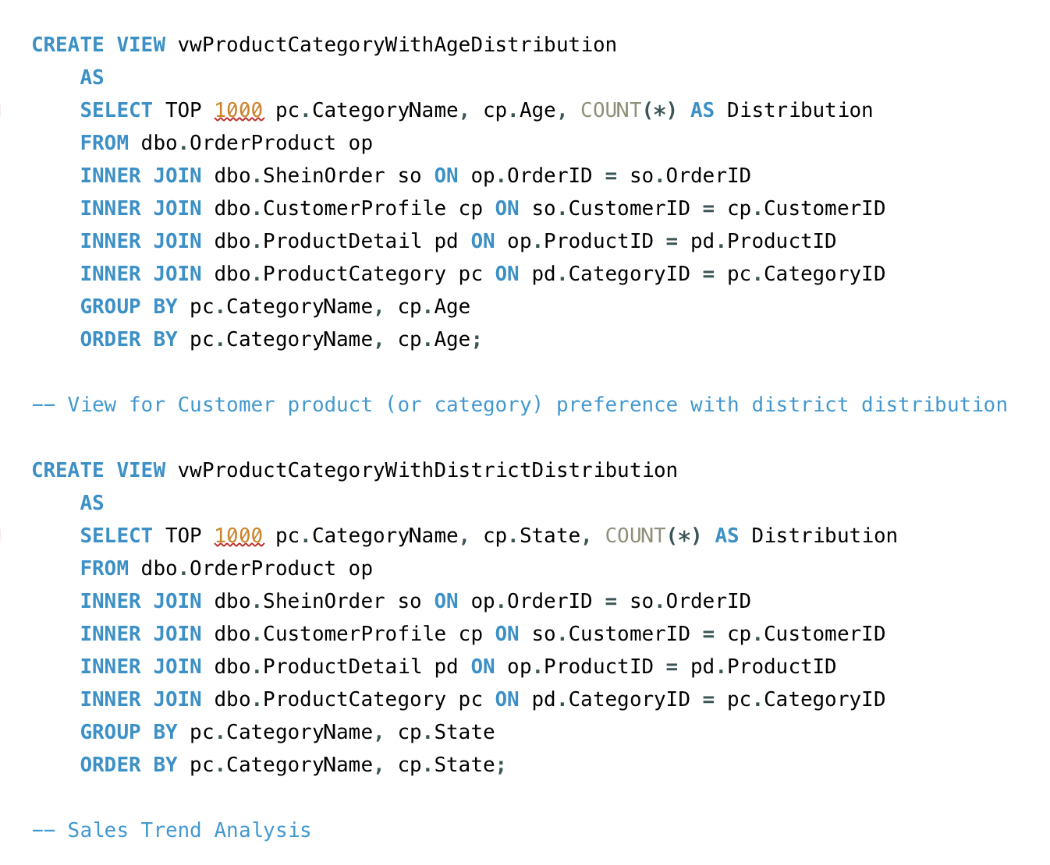
VIEW
Those are some view queries sample below

Slide 19
4. Data Visualization
Customer Profile
Customer Preference
Products

Slide 20
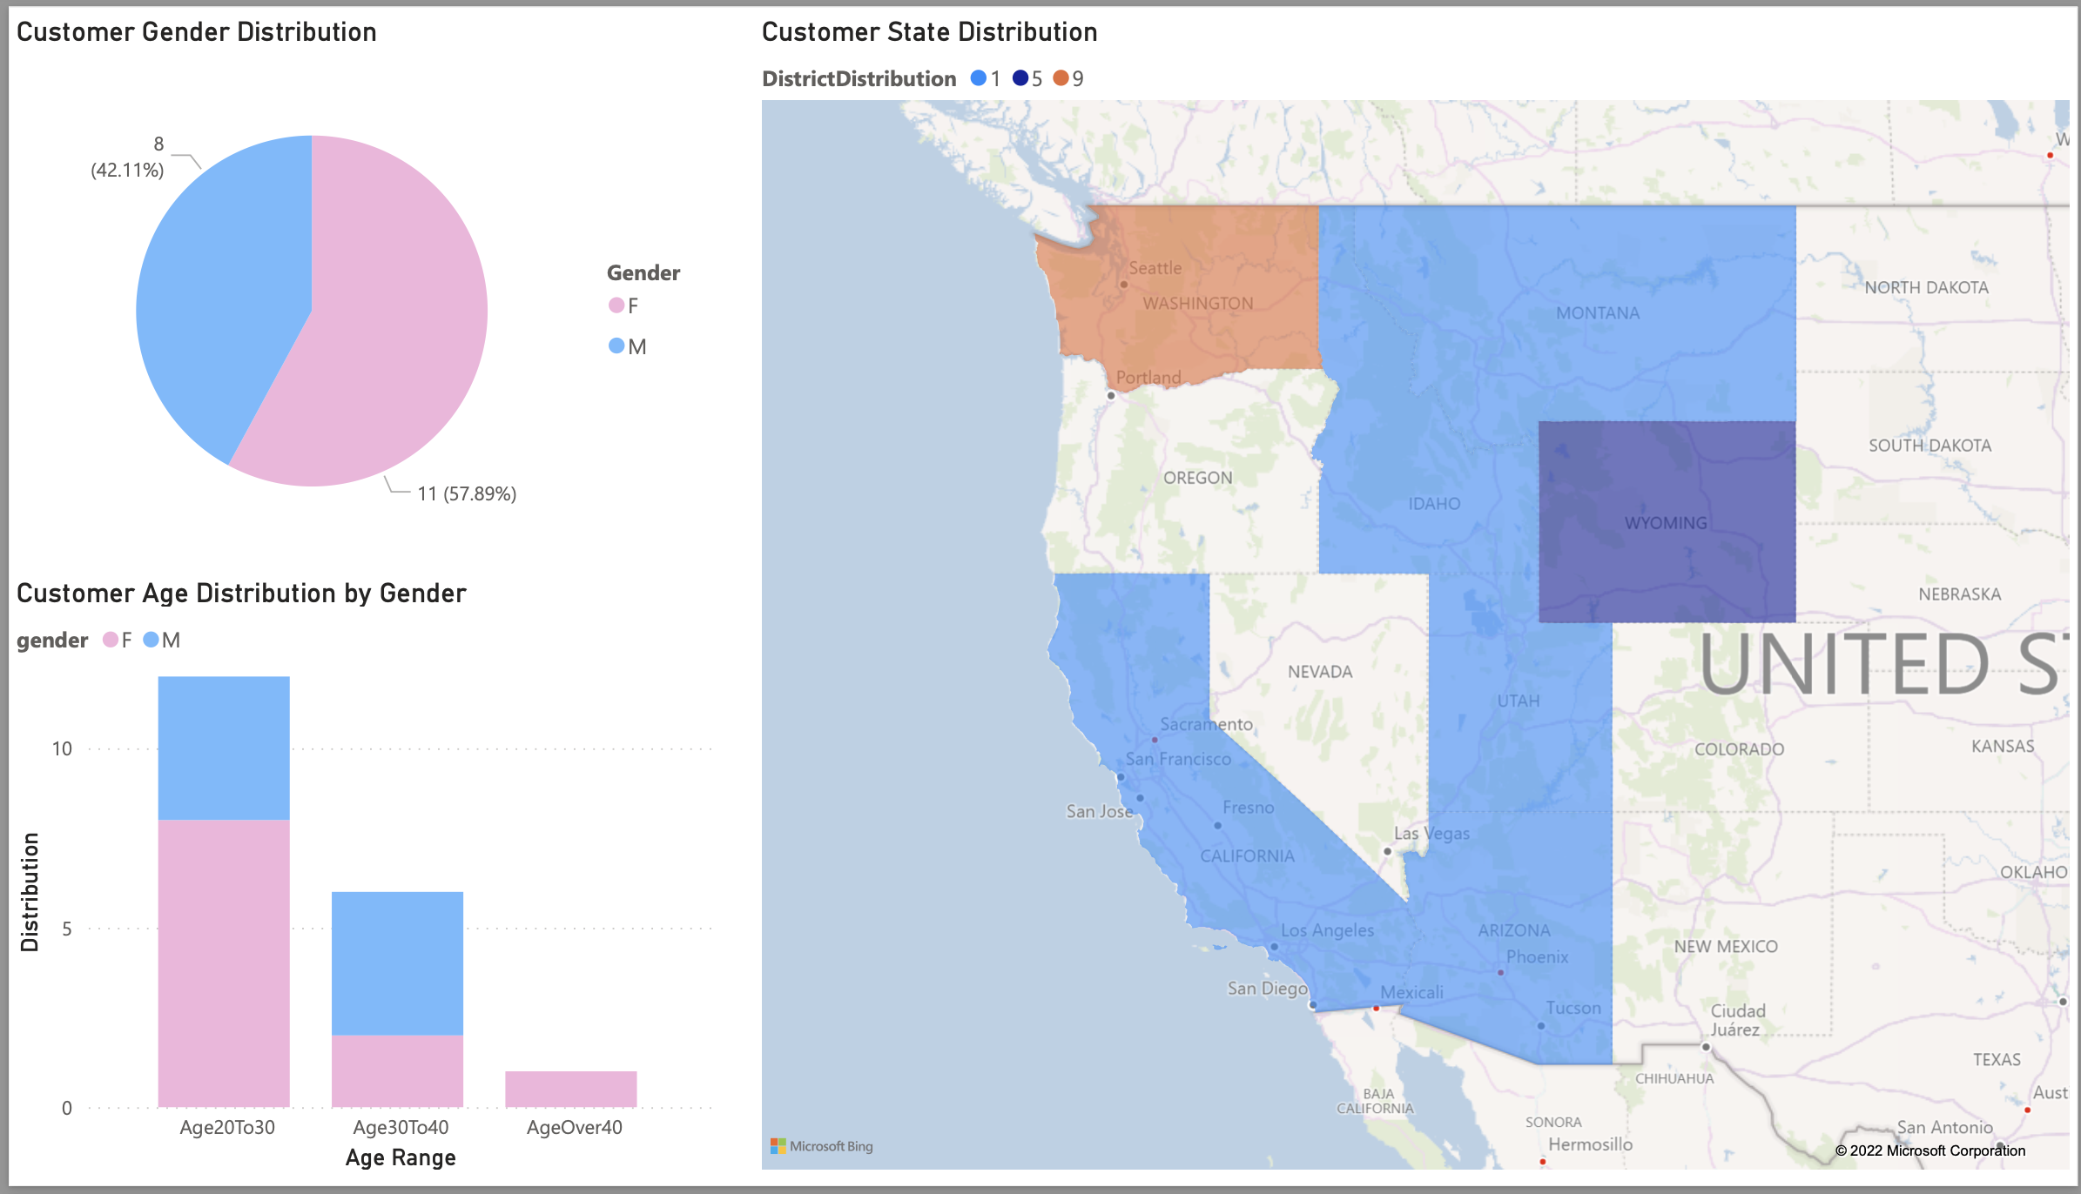
4.1 Customer Profile Analysis

Slide 21
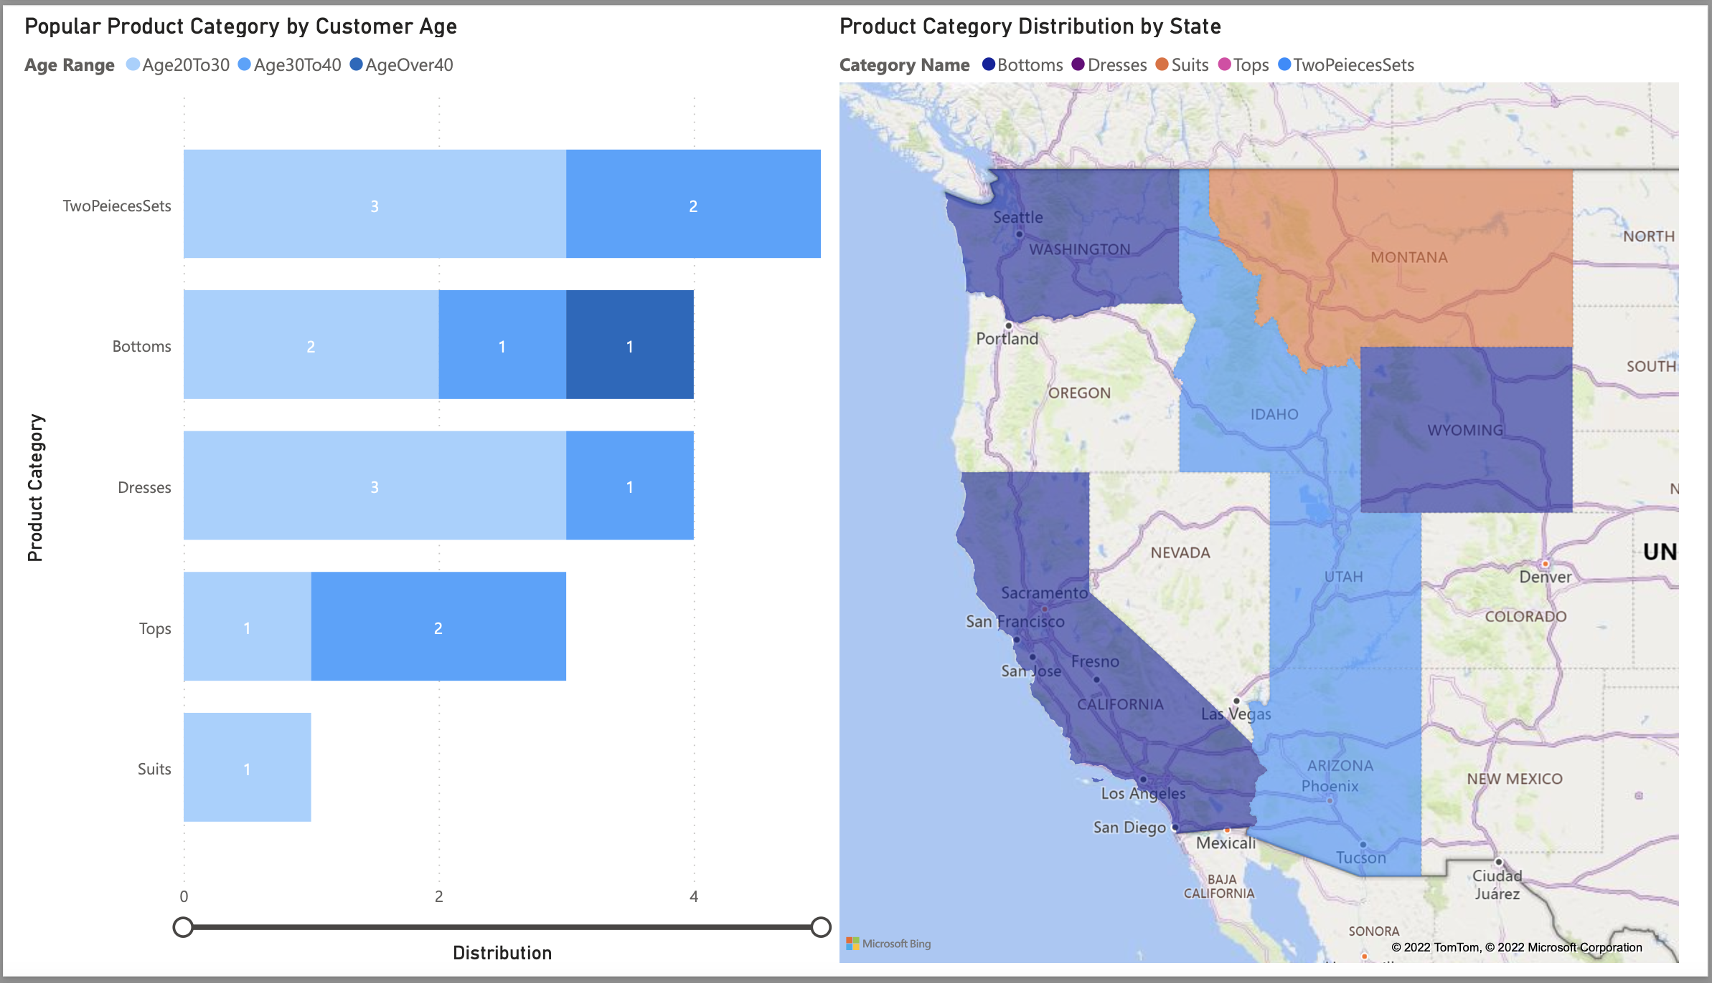
4.2 Customer Preference on Product Category Analysis

Slide 22
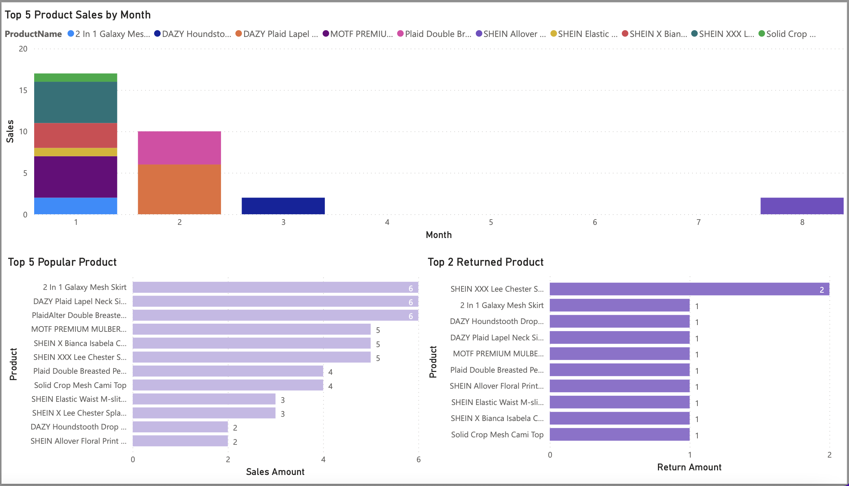
4.3 Products analysis

Slide 23

Q&A

Slide 24
Thanks!

